Slide 1

CENG 789 – Digital Geometry Processing
07- Shape Generation
Assoc. Prof. Yusuf Sahillioğlu
Computer Eng. Dept, , Turkey

Slide 2
Shape Synthesis / Mesh Generation
<number> / 71
Previously, we dealt with generation of meshes that represent shape surfaces from implicit scalar fields (in an effort to perform scientific visualization).
One can also generate meshes (= synthesize shapes) by growing or learning a shape space.
A totally different approach will also be discussed in the end (Shape from X).

Slide 3
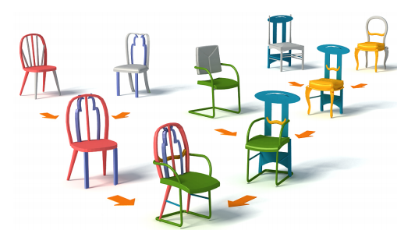
Part-based Shape Synthesis
<number> / 71
One of the advantages of using digital models is the simplicity to generate new models based on the seed models.
One method is shuffling and deforming existing parts in correspondence.
Genetic algo: crossovers (shuffling) and mutations (deformations).
Paper: Set Evolution for Inspiring 3D Shape Galleries.

Slide 4
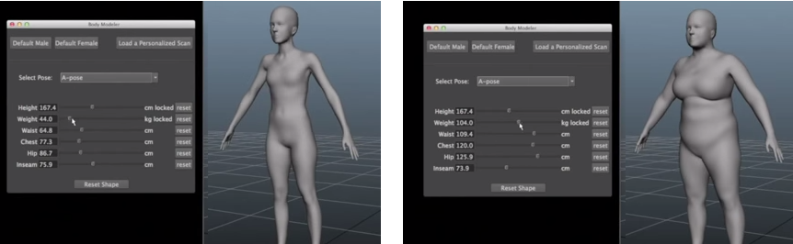
PCA-based Shape Synthesis
<number> / 71
One of the advantages of using digital models is the simplicity to generate new models based on the seed models.
We will learn a different approach: learning shape space via PCA.

Slide 5
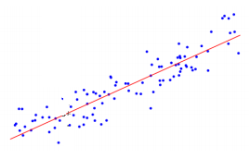
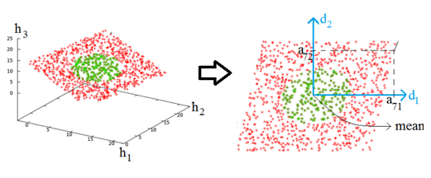
PCA-based Shape Synthesis
<number> / 71
One of the advantages of using digital models is the simplicity to generate new models based on the seed models.
We will learn a different approach: learning shape space via PCA.

Slide 6
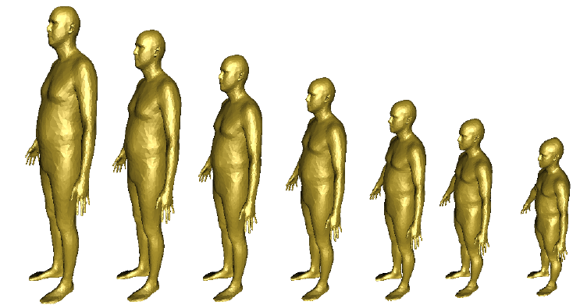
PCA-based Shape Synthesis
<number> / 71
One of the advantages of using digital models is the simplicity to generate new models based on the seed models.
Having learned the variation below, synthesize the next shape.

Slide 7
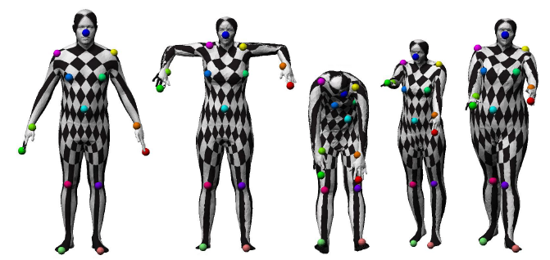
PCA-based Shape Synthesis
<number> / 71
One of the advantages of using digital models is the simplicity to generate new models based on the seed models.
How about this variation?

Slide 8
PCA
<number> / 71
PCA: Principal Component Analysis.
PCA: given a point* set, PCA finds a good orthogonal basis that represents these points well.
PCA: given a point set, PCA finds a good orthogonal basis that is well-aligned with data.
PCA: discovers directions among which data has big variation.
* Note that points may represent shapes as well, e.g., we are in R³⁰⁰⁰ for 1000-vertex mesh in 3D.

Slide 9
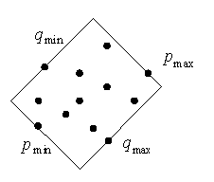
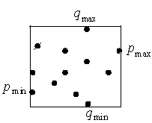
PCA Applications
<number> / 71
Line fit, plane fit.
Dimension reduction.
Oriented bounding box (OBB) computation.
This is axis aligned bounding box (AABB).

Slide 10
PCA Applications
<number> / 71
Line fit, plane fit.
Dimension reduction.
Oriented bounding box (OBB) computation.
  Dot products to get p/q min/max.

Slide 11
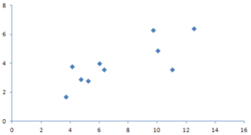
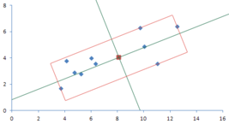
PCA Applications
<number> / 71
Line fit, plane fit.
Dimension reduction.
Oriented bounding box (OBB) computation.
  Dot products to get p/q min/max.
  Projecting (blue) to principal components (green) gives the p/q min/max.

Slide 12
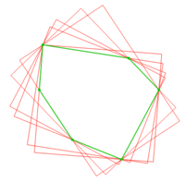
PCA Applications
<number> / 71
Line fit, plane fit.
Dimension reduction.
Oriented bounding box (OBB) computation.
  Rotating Calipers method based on the fact that OBBB has a side collinear w/ one of the edges of pnt set’s convex hull (1975 Freeman theorem.)
  Reds are OBB candidates for the green convex hull (linear time). Answer: Min-area red is the OBBB.

Slide 13
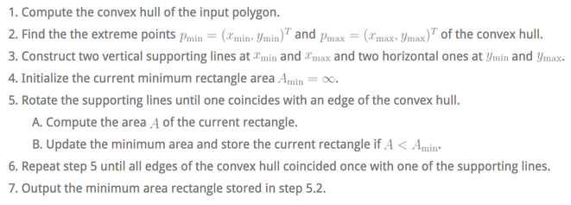
PCA Applications
<number> / 71
Line fit, plane fit.
Dimension reduction.
Oriented bounding box (OBB) computation.
  Rotating Calipers:

Slide 14


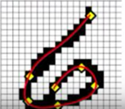
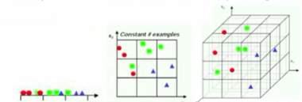
PCA Motivation
<number> / 71
A way to prevent Curse of Dimensionality.
High dimensionality is a problem ‘cos your space grows very quickly but the number of examples you have stays the same ➔ Redundancy.
20x20 bitmap to draw digits: 2⁴⁰⁰ dimensions but most of the configs will never be observed anyway, e.g.,
True dimensionality is about how much
variation I’ve when writing a digit, e.g.,
Same # examples in 3 regions (1D),
3² regions, 3³ regions, .. ➔ Sparse observations.

Slide 15
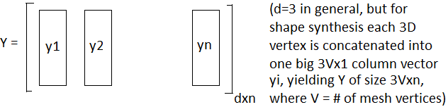
PCA Computation
<number> / 71
Compute center of mass m of n data points x1 to xn.
Translate data points so that origin is at m: yi = xi – m for 1≤i≤n.
Given matrix
compute scatter (covariance) matrix S = YY^{T} measuring the variance
of points in different directions.
Eigenvectors of S (in the descending order of associated eigenvalues) give the desired principal directions.

Slide 16

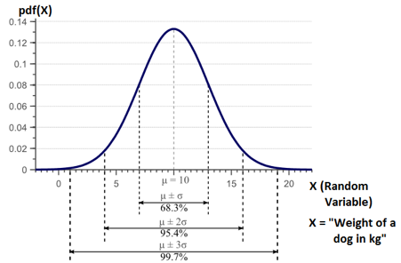
Variance vs. Covariance
<number> / 71
Variance represents the spread of the data points:
Variance is the square of the standard deviation .
If data is normally distributed, 68.3% of the observations/samples will have a value b/w and , where is the mean of the data pts.
  Hence, normally distributed data can be characterized by mean and variance.
Here is a probability density function for normally distributed data:

Slide 17
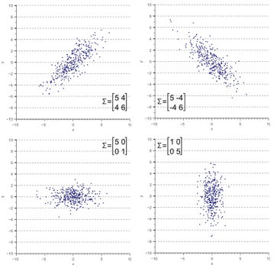


Variance vs. Covariance
<number> / 71
Variance represents the spread of the data points in axis-aligned directions, e.g., x-direction ( ) or y-direction ( ) for 2D data.
However, horizontal and vertical spreads may not be enough, e.g., they do not explain the clear diagonal correlation below:
  On average, if x increases, so does y;
  hence a positive correlation captured
  by ,
  and summarized in this
  covariance matrix:
  Symmetric matrix w/ variances on
  diagonal, covariances off-diagonal.

Slide 18
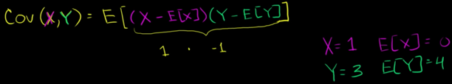

Variance vs. Covariance
<number> / 71
Covariance b/w 2 attributes (X and Y here) is an indication of whether they change together or in opposite directions.
X and Y are my random variables. Take one point sample w/ X=1, Y=3.
I know their means in advance: E[X]=0, E[Y]=4.
For this sample, X is above average, but Y is below. So, it looks like as X is growing (above mean), Y is sinking. If this pattern continues for all the samples (sum), we have a negative covariance b/w X and Y.

Slide 19
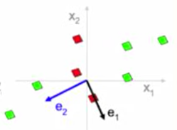
Variance vs. Covariance
<number> / 71
Covariance b/w 2 attributes (X and Y here) is an indication of whether they change together or in opposite directions.
More on intuition: green and red pnts contribute +vely and –vely, resp.
  Mean at the origin; e.g., for rightmost pnt x1 & x2 higher than the means 0, 0.

Slide 20
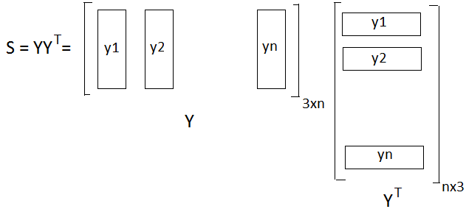
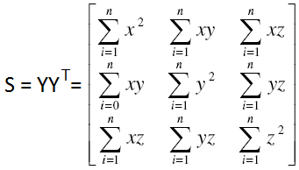
Variance vs. Covariance
<number> / 71
2D data is fully explained by its mean and 2x2 covariance matrix.
3D data is fully explained by its mean and 3x3 covariance matrix.
Recall that origin (0,0) is at center of mass of the data points, hence mean x and mean y are both 0.

Slide 21

Variance vs. Covariance
<number> / 71
2D data is fully explained by its mean and 2x2 covariance matrix.
3D data is fully explained by its mean and 3x3 covariance matrix.
Example: variance b/w x-coordinates = .27, y-coordinates = .25, and covariance b/w x- and y-coordinates = -.26 here: (no variance between z-coordinates).

Slide 22
Eigendecomposition of Covariance Matrix
<number> / 71
Recall that eigenvectors of the covariance matrix S give the desired principal directions of variations, i.e., principal components (Slide 15).
Eigenvalues represent the variance of data along the corresponding eigenvector directions; so pick the components w.r.t. eigenvalues.
In 3D, all eigenvalues similar → no preferred direction, i.e., sphere.
In 3D, one tiny eigenvalue → data sampled on a plane whose normal is that tiny eigenvalue (this is how we fit planes to 3D data).
In 2D, all eigenvalues similar → circle.
In 2D, one tiny eigenvalue → line whose direction is the big eigenvalue (this is how we fit lines to 2D data).

Slide 23
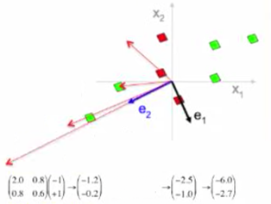
Eigendecomposition of Covariance Matrix
<number> / 71
Why do the eigenvectors of the covariance matrix S give the desired principal directions of variations, i.e., principal components (Slide 15)?
Take any vector, e.g., [-1 1]^{T}, transform it via S, get [-1.2 -0.2]^{T}, repeat.
Turns out, multiplying by S spins the initial vector towards direction of the greatest variance. It is also scaled along the way but it’s OK.
So, look for vectors that do not get turned when multiplied by S, hence look for eigenvectors of S.
Eigenvector of a transformation M is a vector that has not changed at all after transformation M except by a scalar known as the eigenvalue: Mv = λv, where v is an eigenvector of M w/ the eigenvalue λ.
Notes:
Nice set of videos on PCA: https://www.youtube.com/playlist?list=PLBv09BD7ez_5_yapAg86Od6JeeypkS4YM

Slide 24
Eigenvector Pop Quiz
<number> / 71
How many eigenvectors does a 2D reflection matrix have, and geometric meaning?
  2: along the reflection line and perpendicular to the reflection line.
Same for i) 3D uniform scaling mtrx? ii) 2D rotation mtr? iii) 3D rot. m?
  Infinitely many: every vector preserves direction and changes magnitude after uniform scaling matrix is applied.
  0: all 2D vectors get turned.
  1: all but 1 (axis of rotation) 3D vectors get turned.
M =
Eigenvector of a transformation M is a vector that has not changed at all after transformation M except by a scalar known as the eigenvalue: Mv = λv, where v is an eigenvector of M w/ the eigenvalue λ. In the example above, λ = 3.

Slide 25
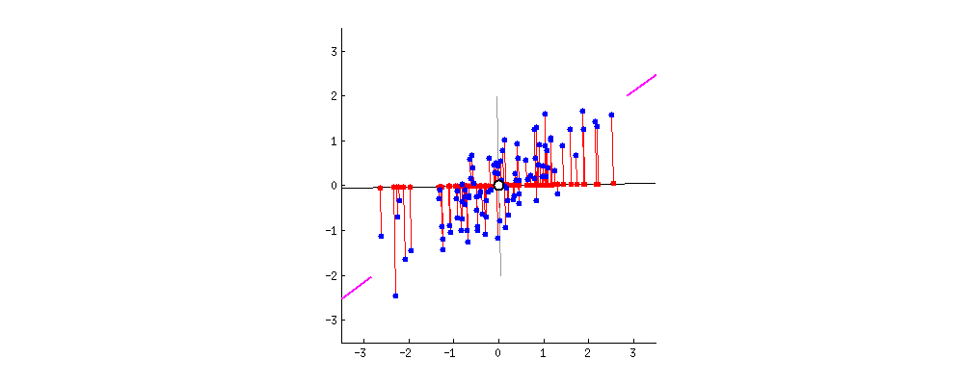
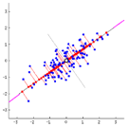
PCA Summary
<number> / 71
PCA finds the best possible characteristics, best summary of data.
Best: maximum variance/spread occurs along the principal direction.
Best: minimum error (total red line length) along the principal directin.

Slide 26
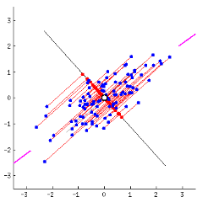
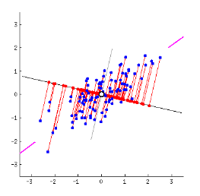
PCA Summary
<number> / 71
Why does max variance give min error, or vice versa?
Variance: average squared distance from center to each red dot.
Error: average squared red line lengths.
Average squared distance from center to each blue dot is constant.
Constant = Variance + Error by Pythagoras Theorem.
  So the higher the variance the lower the error, viceversa (to keep the sum constant).

Slide 27
PCA Summary
<number> / 71
PCA constructs this cool principal direction which provides the max variance, min error (and the other orthonormal directions, which are the next principals).

Slide 28
Linear Algebra w/ Geometric Perspective
<number> / 71
For a geometric interpretation of eigenstuff, let’s visualize what matrices do: they represent linear transformations.
  v’ = Mv is the linearly transformed version of v.
  Rotation, scaling, reflection, shear are common linear transforms.
  A transformation is linear if lines remain lines & origin remains fixed
Notes:
Translation is not linear as it moves the origin. Hence no translation matrix in standard coordinates. We use homogenous coordinates to make translation linear, and therefore representable by a matrix. Once translation is also a matrix, we can apply consecutive transformations in the same matrix multiplication pipeline. That’s why we use homogenous coordinates in Computer Graphics.

Slide 29
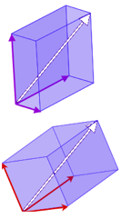

Basis
<number> / 71
For a geometric interpretation of eigenstuff, let’s visualize what matrices do: they represent linear transformations.
  v’ = Mv is the linearly transformed version of v.
  Rotation, scaling, reflection, shear are common linear transforms.
  A transformation is linear if lines remain lines & origin remains fixed
Any matrix can be analyzed by studying its operation on the basis vectors of the space, e.g., standard basis: i=(1,0,0), j=(0,1,0),k=0,0,1
Basis: linearly independent set of vectors that span the vector space.
    Any vector in vector space (white) can be represented as a linear combination of basis vectors (purple set, or red set).
    A good basis often consists of orthogonal vectors, e.g., i, j, k.
    Orthogonality implies linear independence but not vice versa.
    Orthonormality: 2 vectors are orthogonal and unit (length=1).

Slide 30
Basis
<number> / 71
For a geometric interpretation of eigenstuff, let’s visualize what matrices do: they represent linear transformations.
  v’ = Mv is the linearly transformed version of v.
  Rotation, scaling, reflection, shear are common linear transforms.
  A transformation is linear if lines remain lines & origin remains fixed
Any matrix can be analyzed by studying its operation on the basis vectors of the space, e.g., standard basis: i=(1,0,0), j=(0,1,0),k=0,0,1
Basis: linearly independent set of vectors that span the vector space.
    Any vector in vector space (white) can be represented as a linear combination of basis vectors (purple set, or red set).
    A good basis often consists of orthogonal vectors, e.g., i, j, k.
    Orthogonality implies linear independence but not vice versa.
    Orthonormality: 2 vectors are orthogonal and unit (length=1).

Slide 31
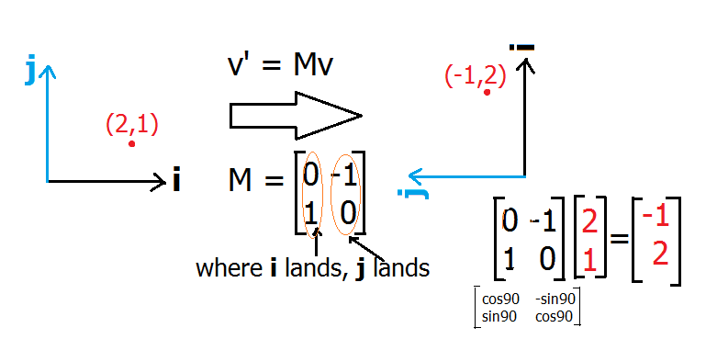
Matrix
<number> / 71
For a geometric interpretation of eigenstuff, let’s visualize what matrices do: they represent linear transformations.
  v’ = Mv is the linearly transformed version of v. M: linear operator.
  Rotation, scaling, reflection, shear are common linear transforms.
  A transformation is linear if lines remain lines & origin remains fixed
Any matrix can be analyzed by studying its operation on the basis vectors of the space, e.g., standard basis: i=(1,0,0), j=(0,1,0),k=0,0,1
  Columns of M are the landing points of basis vectors of the space.

Slide 32
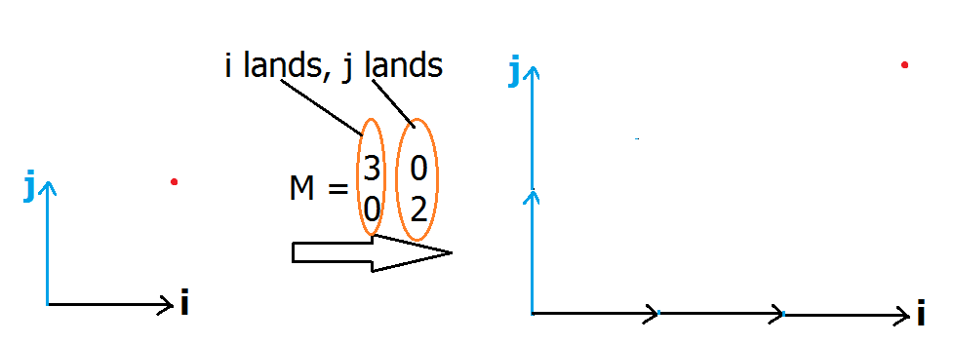
Matrix
<number> / 71
For a geometric interpretation of eigenstuff, let’s visualize what matrices do: they represent linear transformations.
  v’ = Mv is the linearly transformed version of v. M: linear operator.
  Rotation, scaling, reflection, shear are common linear transforms.
  A transformation is linear if lines remain lines & origin remains fixed
Any matrix can be analyzed by studying its operation on the basis vectors of the space, e.g., standard basis: i=(1,0,0), j=(0,1,0),k=0,0,1
  Columns of M are the landing points of basis vectors of the space.
  det(M) = 6 is the scale factor by which areas are transformed by M.

Slide 33
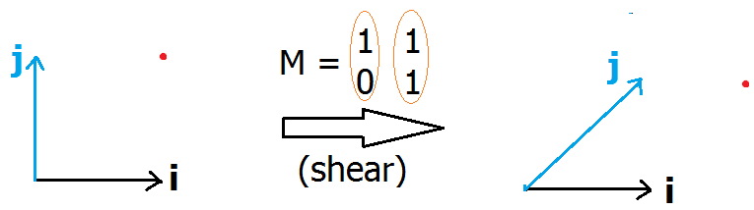
Matrix
<number> / 71
For a geometric interpretation of eigenstuff, let’s visualize what matrices do: they represent linear transformations.
  v’ = Mv is the linearly transformed version of v. M: linear operator.
  Rotation, scaling, reflection, shear are common linear transforms.
  A transformation is linear if lines remain lines & origin remains fixed
Any matrix can be analyzed by studying its operation on the basis vectors of the space, e.g., standard basis: i=(1,0,0), j=(0,1,0),k=0,0,1
  Columns of M are the landing points of basis vectors of the space.

Slide 34
Eigenvectors and Eigenvalues
<number> / 71
Eigenvector of a transformation M is a vector that has not changed at all after transformation M except by a scalar known as the eigenvalue.
Mv = λv, where v is an eigenvector of M w/ the eigenvalue λ.
Eigendecomposition: M = VΛV^{T} (aka Spectral Decomposition).

Slide 35
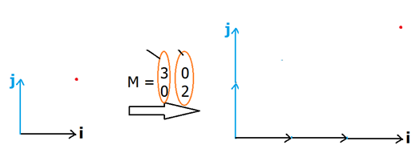
Eigenvectors and Eigenvalues
<number> / 71
Eigenvector of a transformation M is a vector that has not changed at all after transformation M except by a scalar known as the eigenvalue.
Mv = λv, where v is an eigenvector of M w/ the eigenvalue λ.
2 eigenvectors for this M: [1 0]^{T} and [0 1]^{T} w/ eigvals 3 and 2, resptvly
3 0 1 1 3 0 0 0
0 2 0 0 0 2 1 1
Any vector in eigvector direction, e.g., [9 0]^{T}, is still an eigenvector w/ the same eigenvalue; ordinarily we consider eigenvectors as unit vectors.
= 3
= 2

Slide 36
Eigenvectors and Eigenvalues
<number> / 71
Eigenvector of a transformation M is a vector that has not changed at all after transformation M except by a scalar known as the eigenvalue.
Mv = λv, where v is an eigenvector of M w/ the eigenvalue λ.
Uniform scale by 2 has all vectors as eigvectors but one eigvalue of 2.
Eigenvalue can be visualized as stretch amount of the original vector.
2 0 1 1 2 0 9 9
0 2 0 0 0 2 5 5
= 2
= 2

Slide 37
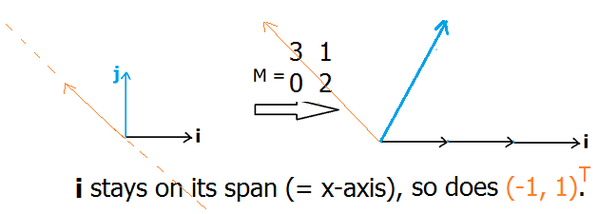
Eigenvectors and Eigenvalues
<number> / 71
Eigenvector of a transformation M is a vector that has not changed at all after transformation M except by a scalar known as the eigenvalue.
Mv = λv, where v is an eigenvector of M w/ the eigenvalue λ.
2 eigenvectors for this M: [1 0]^{T} and [-1 1]^{T} w/ eigvls 3 and 2, resptvly
3 1 1 1 3 1 -1 -1
0 2 0 0 0 2 1 1
= 3
= 2

Slide 38
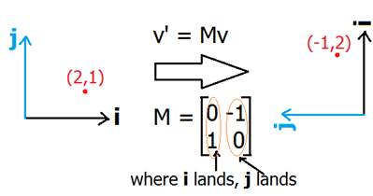
Eigenvectors and Eigenvalues
<number> / 71
Eigenvector of a transformation M is a vector that has not changed at all after transformation M except by a scalar known as the eigenvalue.
Mv = λv, where v is an eigenvector of M w/ the eigenvalue λ.
No eigenvectors for this M:
(2D rotation has no eigvecs ‘cos
all vectors change direction.)

Slide 39
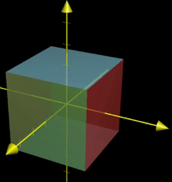
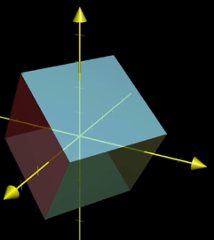
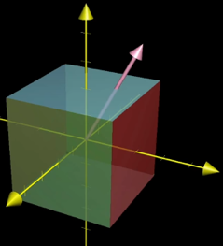
Eigenvectors and Eigenvalues
<number> / 71
Eigenvector of a transformation M is a vector that has not changed at all after transformation M except by a scalar known as the eigenvalue.
Mv = λv, where v is an eigenvector of M w/ the eigenvalue λ.
An eigenvector of 3D rotation (3x3 M) is the axis of rotation, as it stays on its span.
Corresponding eigenvalue is 1 as rotations don’t stretch/squish objects.
Eigenvector
M of M (pink):

Slide 40
PCA-based Shape Synthesis
<number> / 71
Back to business after that algebraic detour.
One of the advantages of using digital models is the simplicity to generate new models based on the seed models.
Having learned the variation below, synthesize the next shape.

Slide 41
PCA-based Shape Synthesis
<number> / 71
Learn the shape space through PCA.
Correlate semantic attributes and PCA coordinates.
Create new shape based on new attributes.
  No fancy devices/scanners, just simple keyboard inputs.

Slide 42
PCA Computation
<number> / 71
Compute center of mass m of n data points x1 to xn.
Translate data points so that origin is at m: yi = xi – m for 1≤i≤n.
Given matrix
compute scatter (covariance) matrix S = YY^{T} measuring the variance
of points in different directions.
Eigenvectors of S (in the descending order of associated eigenvalues) give the desired principal directions.

Slide 43
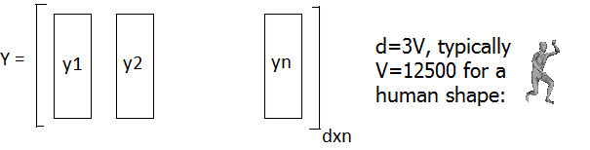
PCA Computation
<number> / 71
Compute center of mass m of n shapes x1 to xn. m: mean shape.
Translate shapes so that origin is at m: yi = xi – m for 1≤i≤n.
Given matrix
compute scatter (covariance) matrix S = YY^{T} measuring the variance
of points in different directions.
Eigenvectors of S (in the descending order of associated eigenvalues) give the desired principal directions.
The set of eigenvectors representing surface data in this manner is called an active shape model, or statistical shape model.

Slide 44
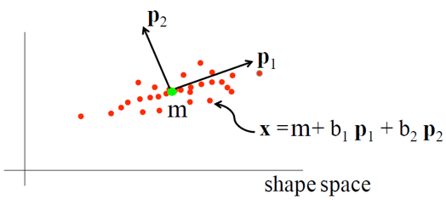
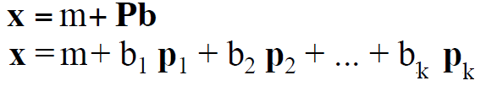
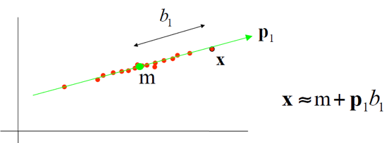
Active Shape Model
<number> / 71
The set of eigenvectors representing surface data in this manner is called an active shape model, or statistical shape model.
m: mean shape.
Linear model: x = m + Pb
We don’t lose much by
approximating the new
shape x using few
dimensions.

Slide 45
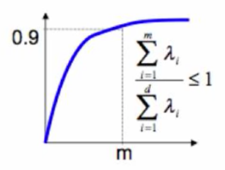
PCA Computation
<number> / 71
How many principal components do we need?
We want to capture as much variation as possible.
Eigenvalue λ_{i} gives the amount of variation in the i^{th} direction.
One heuristic: pick the first m largest eigenvectors which explain 90+% of the total variance, i.e., sum of the first m eigenvalues over sum of all the eigenvalues is at least 0.9.

Slide 46
PCA Computation
<number> / 71
S = YY^{T} is huge (3V x 3V) → difficult to compute eigenvectors.
Since there are only n samples (n << 3V) the rank of S is at most n-1 and therefore there are at most n-1 eigvectors w/ nonzero eigvalues.
Karhunen-Loeve Transform (KLT) does the trick.

Slide 47
PCA Computation
<number> / 71
S = YY^{T} is huge (3V x 3V) → difficult to compute eigenvectors.
Since there are only n samples (n << 3V) the rank of S is at most n-1 and therefore there are at most n-1 eigvectors w/ nonzero eigvalues.
Karhunen-Loeve Transform (KLT) does the trick:
  Instead of computing eigvcs of YY^{T}, compute eigvcs of Y^{T}Y (n x n).
  Denote by p_{i} the eigenvectors of huge YY^{T}, and by q_{i} the eigvctors of small Y^{T}Y; so we have Y^{T}Yq_{i} = λ_{i}q_{i}
  Multiply sides by Y → YY^{T}(Yq_{i}) = (Yλ)_{i}q_{i} = λ_{i}(Yq)_{i}
  Thus, p_{i} = Yq_{i} are the eigenvectors of YY^{T}
  This means that we can compute eigenvectors of small Y^{T}Y and multiply them by Y to get the desired eigenvectors p_{i}.
  Note that each p_{i} is of size 3V x 1 and they are orthonormal.

Slide 48
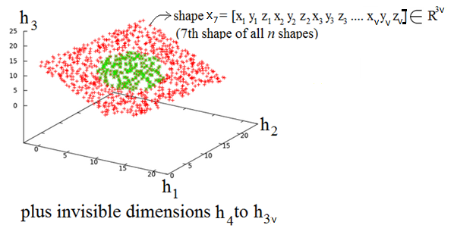
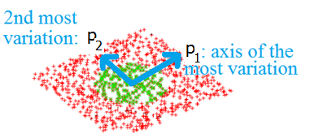
Correlation
<number> / 71
PCA constructs the principal axes of variations.

Slide 49
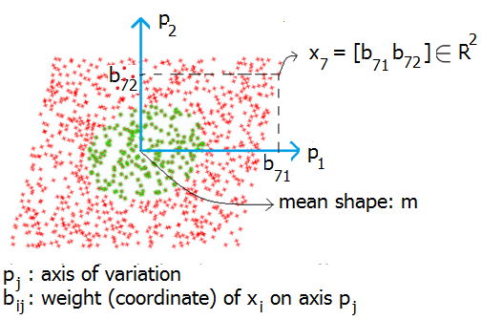
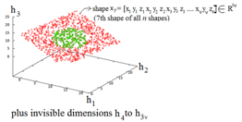

Correlation
<number> / 71
PCA constructs the principal axes of variations, which enables a low dimensional representation to be correlated w/ semantic attributes.

Slide 50
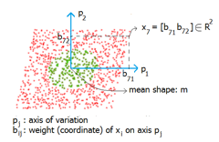
Correlation
<number> / 71
For shape x_{i}, correlation between semantically meaningful input data s_{i} = [kg, cm, ..]^{T} and shape’s PCA coordinates b_{ij} is needed.
Training: s_{i} is defined/precomputed for each shape x_{i} where 1≤i≤n.
Learn correlation matrix C via linear mapping model.
  More sophisticated learning by: Shared Gaussian Process Latent Variable Model.
b = C s_{i} where b = [b_{i1} b_{i2} ..]^{T} for x_{i} (recall s_{i} = [kg, cm, ..]^{T}).
We get n different C matrices which are then averaged into C.
Synthesize a new shape w/ the desired semantic attributes s_{new} via:
  b_{new} = C s_{new}

Slide 51
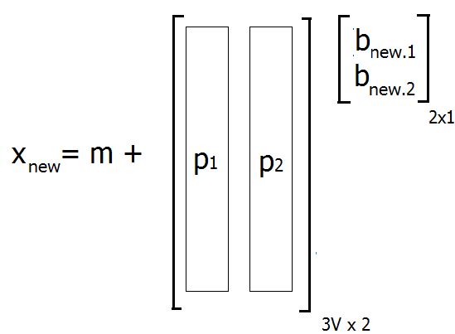
Correlation
<number> / 71
Synthesis based on the new PCA coordinates b_{new} is as follows:
x_{new} = m;
for each principal direction p_{j} in R^{3V}
for each dimension d in b_{new}
x += p_{j.d} * b_{new.d} (where b_{new.d} gives the d^{th} component of b_{new}).
Right, assume p₁ represents variation
in height (y-coord in mesh) and p₂ weight
(z-coord). If b_{new.1} = b_{new.2} = 0, no
change in mean shape. If b_{new.1} = 0,
b_{new.2} = 1, then x_{new} is not stretched
vertically (no change in y). Mean moves
along z on some vertices (change in weight).

Slide 52

Shape to Mesh
<number> / 71
Once the new coordinates are computed via PCA coefficients, it is trivial to get the corresponding shape mesh: keep the connectivity of the mean mesh and change its geometry by the new coordinates.
Note that all the seed shapes in the dataset must initially be in correspondence; this is, e.g., how we get the mean shape: by averaging the coordinates of each corresponding vertex.

Slide 53

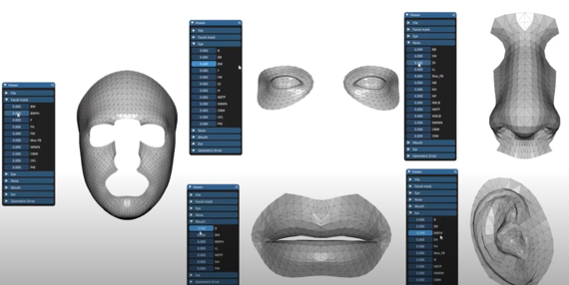
PCA is Global
<number> / 71
A global model may not provide sufficient flexibility/variety.
Part-based scheme for more intuitive modeling.
  Part-Based 3D Face Morphable Model with Anthropometric Local Control, 2020.

Slide 54
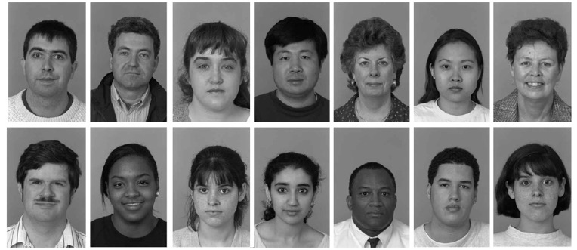
Another PCA App: Eigenfaces
<number> / 71
PCA for shape generation and recognition.
Face images are highly redundant: all background pixels are the same, and each subject has the same facial features.
Eigvcs (called eigenfaces in this context) to represent imgs compactly.
Use this compact representatin to recognize (or create) faces efficiently.

Slide 55
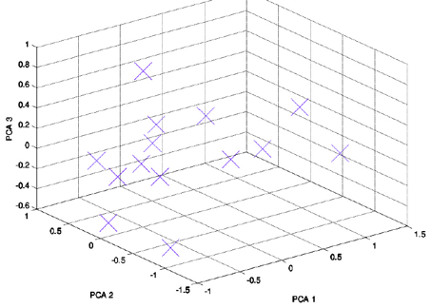
Another PCA App: Eigenfaces
<number> / 71
Use eigenvectors (called eigenfaces in this context) to represent images compactly, e.g., below: just 3 coefficients (weights on 3 principal axes).
Use this compact representation, e.g., 14 images (X) below, to recognize faces efficiently.
  Find the dimension coeffs for the query image and compare it w/ the X’s below.

Slide 56


Another PCA App: Eigenfaces
<number> / 71
Mean:
Four eigenfaces with the largest eigenvalues:
First one: most prominent deviations from the mean in this dataset.

Slide 57

Another PCA App: Eigenfaces
<number> / 71
3 principal components are still a close representation.

Slide 58

Another PCA App: Eigenfaces
<number> / 71
5 principal components are still a close representation. Typically use 40.

Slide 59
Shape from X
<number> / 71
Previously, we dealt with generation of meshes that represent shape surfaces from implicit scalar fields (in an effort to perform scientific visualization).
Today, we learned shape generation by growing an existing set of seed meshes.
A different paradigm to generate meshes, popular in Computer Vision, is based on scanning (active) and photogrammetry (passive).

Slide 60



Shape from Stereo
<number> / 71
A passive technique where we use two images of the real-world object to generate its digital mesh.
Depth ambiguity w/ 1 img: which 3D point on ray OP is projected to p?
Fixed: Find corresponding pixel at right. Intersect new 3D line w/ OP.
Reduce your search to the epipolar line (projection of OP on right img).
  HOG, SURF, SIFT features.

Slide 61


Shape from Structured Light
<number> / 71
An active technique where we actively send laser stripes (or other light structures/stripes) to the real-world object to generate its digital mesh.
With two cameras (unusual):
Laser stripe is used for perfect correspondences (no HOG, .. features).
Shine a laser stripe to object. P projects to a pixel on left. Epipolar line on right cam is intersected w/ stripe there, yielding corresponding pixel.
Intersect OP w/ ÖP to get the desired P.
P = (x, y, z)
O
Ö

Slide 62

Shape from Structured Light
<number> / 71
An active technique where we actively send laser stripes (or other light structures/stripes) to the real-world object to generate its digital mesh.
With one camera (common):
Mapping from 2D image plane to 3D stripe plane (pink sheet) can be estimated via projective transformation (4 correspondences needed).
When projector moves to scan a new slice, coupled camera moves together, preserving transform. params, and we get the next 3D slice.

Slide 63

Shape from Structured Light
<number> / 71
An active technique where we actively send laser stripes (or other light structures/stripes) to the real-world object to generate its digital mesh.
With one camera (common).
Calibration that gives transformation parameters from the image plane to the laser plane requires only 4 known correspondences:

Slide 64

Shape from Silhouette
<number> / 71
A passive technique where we use multiple binary silhouette images of the real-world object to generate its digital mesh.
Intersect the back projections of the visual hulls in 3D. One way to do is via deformation: Shape from Silhouette Using Topology-Adaptive Mesh Deformation.
Another passive technique is semi-automatic: https://youtu.be/Oie1ZXWceqM

Slide 65


Shape from Silhouette
<number> / 71
A passive technique where we use multiple binary silhouette images of the real-world object to generate its digital mesh.
Bounding sphere is deformed towards the target in the guidance of sils.
A 3D point is projected to all silhouettes. If it is out (black pixel) in at least 1 image, it means it is still out so move it further in –normal dir. If it is in (white) on all images, it means it is penetrated so move it back and forth in binary search manner. Stop when at “gray” pixel on all imgs.

Slide 66

Shape from Silhouette
<number> / 71
A passive technique where we use multiple binary silhouette images of the real-world object to generate its digital mesh.
Bounding sphere is deformed towards the target in the guidance of sils.
A 3D point is projected to all silhouettes. If it is out (black pixel) in at least 1 image, it means it is still out so move it further in –normal dir. If it is in (white) on all images, it means it is penetrated so move it back and forth in binary search manner. Stop when at “gray” pixel on all imgs.

Slide 67



Shape from Silhouette
<number> / 71
A passive technique where we use multiple binary silhouette images of the real-world object to generate its digital mesh.
Bounding sphere is deformed towards the target in the guidance of sils.
A 3D point is projected to all silhouettes. If it is out (black pixel) in at least 1 image, it means it is still out so move it further in –normal dir. If it is in (white) on all images, it means it is penetrated so move it back and forth in binary search manner. Stop when at “gray” pixel on all imgs.
G is the bilinear interpolation of the sub-pixelic projection (x’, y’) of the point P and takes values in [0,1]: 0 if neighborhood is all black (0), or 0.5 for combination of black and whites, hence on the boundary (gray).

Slide 68

Shape from Silhouette and Structured Light
<number> / 71
A hybrid technique where we fuse advantages of each method.
Shape from Silhouette is hole-free but concavity insensitive.
Idea | Weakness
 | Hidden Concavity

Slide 69


Shape from Silhouette and Structured Light
<number> / 71
A hybrid technique where we fuse advantages of each method.
Shape from Structured Light is concavity sensitive but may have holes.
Idea | Weakness
 | Occlusion

Slide 70

Shape from Silhouette and Structured Light
<number> / 71
A hybrid technique where we fuse advantages of each method.
Combine their benefits in one framework: Coarse-to-Fine Surface Reconstruction from Silhouettes and Range Data Using Mesh Deformation.

Slide 71


Potential Project Topics
<number> / 71
Representation of all major modes of face/pose variations via PCA.
Paper: A Morphable Model For The Synthesis Of 3D Faces. //FaceGen
  See: https://youtu.be/nice6NYb_WA or youtu.be/KPDfMpuK2fQ blendshapes
Paper: A 3D Morphable Model learnt from 10,000 faces. //more recent
Paper: Efficient and Flexible Deformation Representation for Data-Driven Surface Modeling, or the one in Slide 53.
A paper mentioned during the Shape from X part.

